Slide 1
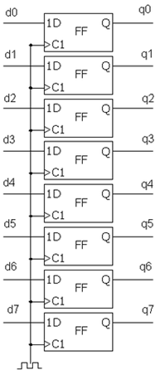
רגיסטר 8 סיביות
Flip-Flop
יחידת חישוב
1D
Q
FF
ALU
C1
1D
Q
FF
MUX
C1
D
1Q
Shift
Register
2Q
3Q
Counter
Compare

Slide 3
Trigger
Configuration
Trigger Type
‘0’
Trigger Position
Clk to start
Reset
System status
Trigger Type
Trigger Position
Clk to start
System status
Clk

Slide 4
Clk
System
status
Reset
System
status
wc to rc
2* Add
width_g
ALU
2* Add_width_g
rc_to_RAM
1D
Q
rc_to_RAM
FF
C1
RAM to rc
Signal_ram_width_g
Signal_ram_width_g
rc_to_WBM
rc_to_WBM
1D
Q
FF
C1

Slide 5
Trigger
‘0’
Reset
Clk
D
1Q
Shift
Register
2Q
Compare
3Q
Clk to start
Trigger
Type
Counter
System
Status
System
Status
Trigger
Position
Addres out
wc to rc
RAM to wc
ALU
WBS to wc

